Slide 1


Data Structures
Week2_Lecture 1
Complexity Analysis
Subhan Ullah, PhD
subhan.ullah@nu.edu.pk
BS(Cybersecurity) Fall-2023

Slide 2
Agenda
Recap
Random Access Machine (RAM) model
Theoretical analysis of running time of an algorithm
Growth rate of an algorithm

Slide 3
Analysis of Algorithm (recap)
Measuring algorithms in terms of the amount of computational resources that the algorithms requires
Storage requirement:
How much memory is required to execute the program?
Running time: How much time is taken to complete the algorithm execution? (In this course we mostly study Running Time)
Different Algorithms for the same problem can have different “Running Times” and different inputs of the same size may result in different running times
Running Time Analysis is based on count of the number of the primitive operations to be executed
Algorithm analysis does not give us the exact running time in seconds. As the execution time duration is dependent on the machine to be used.
We only model Time in terms of input size.

Slide 4
Algorithm analysis for efficiency (Recap)
Suppose we have two algorithms, how can we tell which is better?
Experimental analysis: We could implement both algorithms, run them both
Methodology of experimental analysis
Write a program implementing the algorithm
Run the program with inputs of varying size and composition
Get an accurate measure of the actual running time
Plot the results in a graph or use a table
However, experimental analysis have some limitations
Experimental analysis is difficult and time consuming
Results may not be indicative of the running time on other inputs not included in the experiment
In order to compare two algorithms, the same hardware and software environments must be used
Expensive and error prone

Slide 5
Theoretical Analysis of Running Time (Recap)
Preferably, we should analyze them mathematically (or theoretically)
Uses a pseudo-code description of the algorithm instead of an implementation
Characterizes running time as a function of the input size n
Takes into account all possible inputs (e.g., all best and worst cases)
Can evaluate the speed of an algorithm independent of the hardware/software environment
It is easy to have simple measures for the efficiency of an algorithm instead of implementation or experimental analysis
Limitations
It is impossible to predict the exact behavior of an algorithm as there are too many influencing factors
The analysis is thus only an approximation and not perfect
More importantly, by analyzing different algorithms, we can compare them to determine the best one for our purpose

Slide 6
Analysis of Algorithm (recap)
Measuring algorithms in terms of the amount of computational resources that the algorithms requires
Storage requirement: How much memory is required to execute the program?
Running time: How much time is taken to complete the algorithm execution? (In this course we mostly study Running Time)
Random-Access Machine (RAM) Model
For algorithm analysis, we shall assume a generic one-processor, random-access machine (RAM) model of computation as our implementation technology
and understand that our algorithms will be implemented as computer programs on this machine.

Slide 7
Characteristics of Random-Access Machine (RAM)
It is a standard computational model of generic processor
It gives platform-independence: i.e. the analysis will not depend on any specific architecture
Instructions are executed sequential, one-after another
Entire memory is equally expensive to access
All memory locations accessible in the same constant time
No concurrent operations
All basic instructions take unit time
Constant word size

Slide 8
Analyzing an Algorithm – Operations (Recap)
Each machine instruction is executed in a fixed number of cycles
We may assume each operation requires a fixed number of cycles
Idea: Use abstract machine (RAM model) that uses steps of time instead of secs
Each elementary operation takes 1 steps
Example of operations
Retrieving/storing variables from memory
Assignment operations =
Integer operations + - * / % ++ --
Logical operations && || !
Bitwise operations & | ^ ~
Relational operations == != < <= => >
Memory allocation and deallocation new delete

Slide 9
Analyzing an Algorithm (Recap)
// Input: int A[N], array of N integers
// Output: Sum of all numbers in array A
int SumArray(int A[], int n){
int s=0;
for (int i=0; i< n; i++)
s = s + A[i];
return s;
}
1
2
3
4
5
6
7
8
Operations 1, 2, and 8 are executed once
Operations 4, 5, 6, and 7: Once per each iteration of for loop n iteration
Operation 3 is executed n+1 times
The complexity function of the algorithm is : T(n) = 5n +4

Slide 10
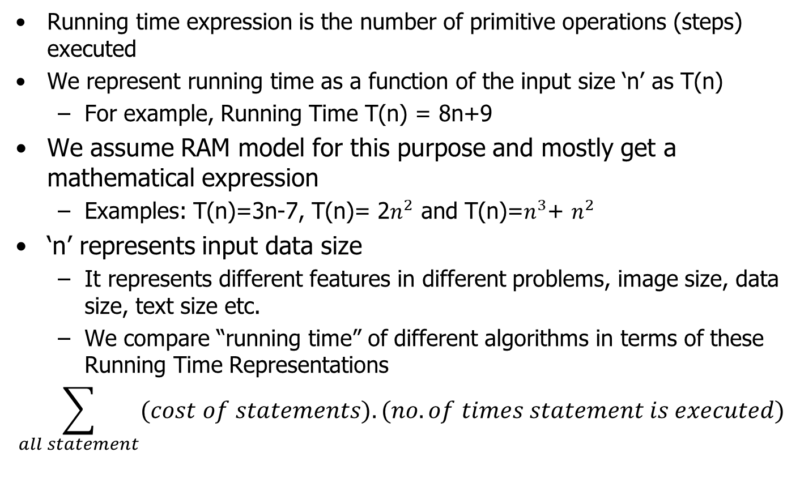
Running Time T(n) Representation
Running time expression is the number of primitive operations (steps) executed
We represent running time as a function of the input size ‘n’ as T(n)
For example, Running Time T(n) = 8n+9
We assume RAM model for this purpose and mostly get a mathematical expression
Examples: T(n)=3n-7, T(n)= 2$n^{2}$ and T(n)=$n^{3}$+ $n^{2}$
‘n’ represents input data size
It represents different features in different problems, image size, data size, text size etc.
We compare “running time” of different algorithms in terms of these Running Time Representations
$$\sum_{all statement}{(cost of statements).(no. of times statement is executed)}$$

Slide 11
Running times and asymptotic notations
Best case: Minimum time required for program execution
Best case calculate the lower bound of an algorithm
Example: In the linear search when search data is present at the first location of large data then the best case occurs
Represented by theta Notation (Θ)
Average case: Average time required for program execution
In the average case take all random inputs and calculate the computation time for all inputs and then we divide it by the total number of inputs
Average case = (all random case time / total no of case)
Represented by big Omega Notation (Ω)
Worst Case: Maximum time required for program execution Worst case calculate the upper bound of an algorithm
Example: In the linear search when search data is not present at all then the worst case occurs
Represented by big Oh Notation (Ο)
Normally, we try to find worst-case behavior of an algorithm

Slide 12
Example (Running time analysis) class activity
Calculate running time (counting of basic operations)
Input: integer n
Output: Sum of all numbers up to n
int sum(int n)
{
int partialSum;
partialSum= 0;
for (int i = 1; i <=n; i++)
partialSum += i * i * i;
return partialSum;
}

Slide 13
Solution
Complexity function: T(N) = 1 + 1 + (N+1) + N + N*(4) + 1 = 6N + 4
So our running time estimate is order of N i.e. O(N).

Slide 14
Example

Slide 15
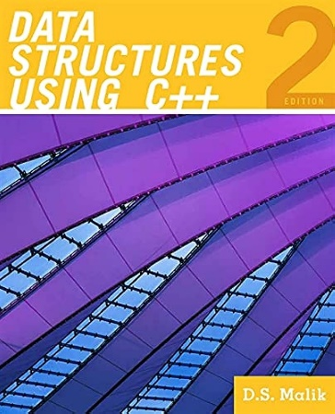
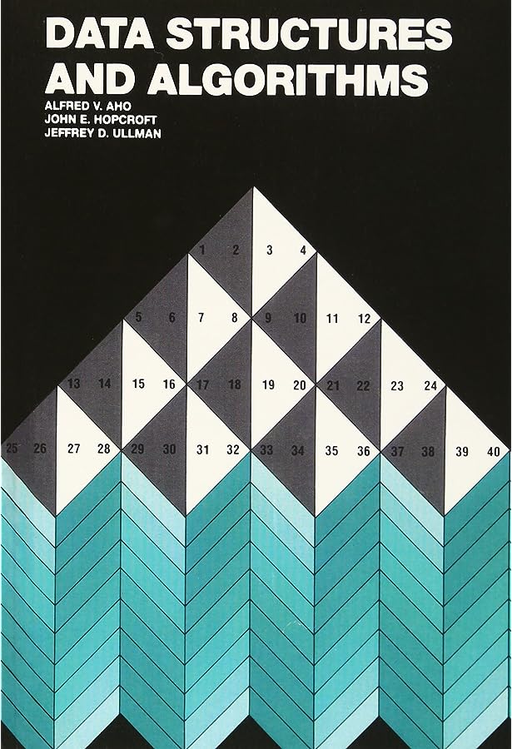
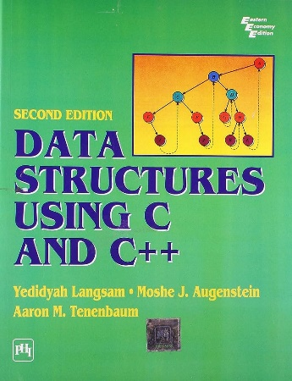
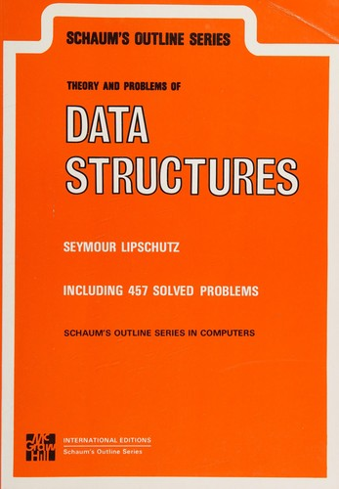
Thank You All
☺
?
A note on the origin of these ppt slides: Thanks to Dr. Zainab FAST-NUCES, ISB and Douglas Wilhelm Harder, M.Math. LEL Department of Electrical and Computer Engineering University of Waterloo Waterloo, Ontario, Canada, I have adopted my slides from their slides.

